Slide 1
COGNIZANT’S QLIK CAPABILITES

Slide 2
AGENDA
Qlik COE
Qlik Methodology
Governance Model
Accelerators
Case Studies

Slide 3
QLIK COE

Slide 4


COGNIZANT’S EXPERIENCE WITH QLIK
Qlikview: 205 People; 42 Accounts
60 Certified Associates
QlikSense: 20 People; 2 Accounts
Global SI Partner
BI environment Assessment / Tool Evaluation
Qlikview / QlikSense Implementation
Report migration to Qlikview / QlikSense Platform
Performance Investigation and Tuning
User Enablement and Migration Services
Research and Consultancy Services
Customer Speak
Partnership
“I want to thank you and your team your hard work developing in a very tight schedule as well as their interest to gather all our suggestions .”
Services Portfolio
Competency
Competency Profile
Senior Manager, Diversified Technology Company
Representative Experiences
Qlikview – Leading Energy and Utilities Company based in UK
QlikSense – Leading Bio-Tech Company based in the US
Provided cost effective solution with Onsite/Offshore model.
Robust and scalable QlikView infrastructure and data model.
Cognizant assessed , proposed and implemented appropriate solution using QlikView.
Cognizant designed flexible data model with 55 dimensions & 10 fact tables, in order to store and build the dashboard and reports .
Improved productivity for the Client’s Executives
Increased Dashboard adoption through enablement programs & helpdesk support
Centralized reusable components, best practices and KPIs
Installed and Configured QlikSense Application Servers.
Cognizant assessed current model and proposed a roll-out plan as per customer priority
Integrated the Base Data model used in the 2 separate application in QlikView into
a single Data model
Created the QlikSense Application for the 2 Brands using the merged Data model with all the possible features available in QlikSense
Implemented a set of flexible dashboards with filters, graphs, cyclic groups,Master Items that enables user to create their own apps with attractive visualization features

Slide 5
CERTIFICATION AND RATES
Accounts & Certifications
Tools | People | Accounts | QlikView Developer Certified | QlikView Admin Certified | QlikSense Data Architect | QlikSense System Administrator
QlikView | 205 | 42 | 48 | 12 | - | -
QlikSense | 20 | 2 | - | - | 1 | 1
Hourly Rates
Role | Cognizant Grade | Offshore | US | UK | CE | Middle East | APAC
Principal Architect | Associate Director | 63 | 188 | 212 | 201 | 147 | 149
Sr. Architect | Senior Manager | 50 | 155 | 144 | 156 | 122 | 123
Architect | Manager | 38 | 131 | 107 | 125 | 100 | 104
Sr. Developer/Technical Lead | Senior Associate | 29 | 117 | 97 | 111 | 82 | 87
Developer/Sr. Developer | Associate | 26 | 96 | 75 | 94 | 67 | 73
Developer | PAT/ PA/ PT/ P | 22 | 83 | 62 | 77 | 47 | 55

Slide 6








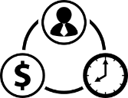
CERTIFICATION AND RATES
Developer
Certified
48
205
People
20
Admin
Certified
12
42
Accounts
2
Data
Architect
1
System
Administrator
1
US
Offshore
UK
APAC
Middle East
CE
Hourly Rates
Principal Architect
Associate Director
188
212
147
201
149
63
Sr. Architect
Senior Manager
155
144
122
156
123
50
Architect
Manager
131
107
100
125
104
38
Technical Lead
Senior Associate
117
97
82
111
87
29
Sr. Developer
Associate
96
75
67
94
73
26
Developer
PAT/ PA/ PT/ P
83
62
47
77
55
22

Slide 7
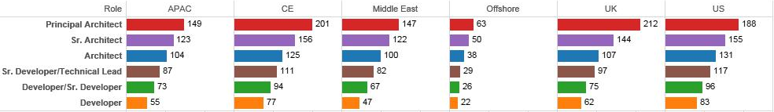
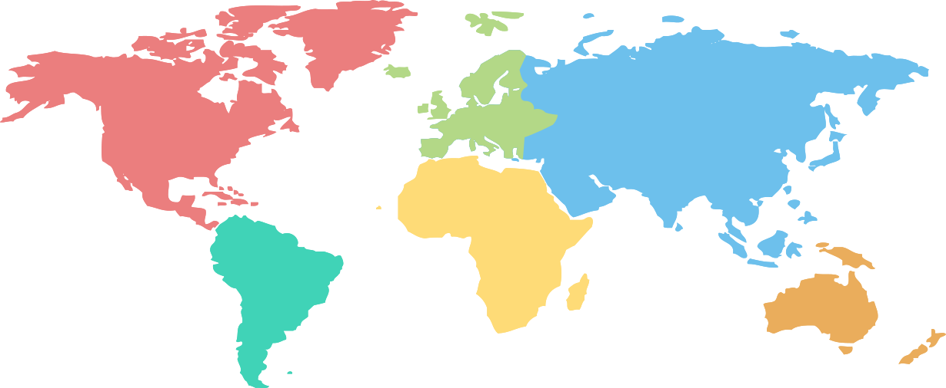
117
155
131
188
96
83

Slide 8
Principal Architect
Sr.
Architect
Architect
Technical Lead
Sr. Developer
Developer
US
188
155
131
117
96
83
UK
212
144
107
97
75
62
Middle East
147
122
100
82
67
47
CE
201
156
125
111
94
77
APAC
149
123
104
87
73
55
117
Offshore
63
50
38
29
26
22
155
131
188
96
83

Slide 9
Hourly Rates
Principal Architect
Sr.
Architect
Architect
Technical Lead
Sr. Developer
Developer
US
188 $
155 $
131 $
117 $
96 $
83 $
UK
212 $
144 $
107 $
97 $
75 $
62 $
Middle East
147 $
122 $
100 $
82 $
67 $
47 $
CE
201 $
156 $
125 $
111 $
94 $
77 $
APAC
149 $
123 $
104 $
87 $
73 $
55 $
117
Offshore
63 $
50 $
38 $
29 $
26 $
22 $
155
131
188
96
83

Slide 10
Hourly Rates
US
UK
Middle East
CE
APAC
Offshore
Principal Architect
188 $
188 $
188 $
188 $
188 $
188 $
US
Sr.Architect
155 $
155 $
155 $
155 $
155 $
155 $
UK
212 $
144 $
107 $
97 $
75 $
62 $
Architect
131 $
131 $
131 $
131 $
131 $
131 $
Middle East
147 $
122 $
100 $
82 $
67 $
47 $
Technical Lead
117 $
117 $
117 $
117 $
117 $
117 $
Sr. Developer
96 $
96 $
96 $
96 $
96 $
96 $
CE
201 $
156 $
125 $
111 $
94 $
77 $
Developer
83 $
83 $
83 $
83 $
83 $
83 $
APAC
149 $
123 $
104 $
87 $
73 $
55 $
Offshore
63 $
50 $
38 $
29 $
26 $
22 $

Slide 11

Hourly Rates
US
Offshore
UK
APAC
Middle East
CE
Principal Architect
Principal Architect
188
188
188
188
188
188
Sr. Architect
Sr. Architect
155
155
155
155
155
155
Architect
Architect
131
131
131
131
131
131
Technical Lead
Technical Lead
117
117
117
117
117
117
Sr. Developer
Sr. Developer
96
96
96
96
96
96
Developer
Developer
83
83
83
83
83
83

Slide 13

COGNIZANT PARTNERSHIP WITH QLIK
Cognizant has a Global SI Partnership with QlikView since 2011
Before forming this partnership Cognizant teams have been collaborating with QlikView on business pursuits, proof of concepts engagements and delivery engagements
This relationship provides Cognizant an edge to deliver advanced business intelligence/analytics, data discovery, advanced visualization and mobility solutions to its customers
Global SI Partner
Customer Direct Benefits (Our Investments)
Customer Indirect Benefits (Our Partnership with QlikView)
Building POCs, and joint solution which can be leveraged to kick start QlikView implementation
Strong QlikView Centre of Excellence
Thought leadership and management: Benchmarking, Standards, Best Practices & Guidelines
Joint Advisory Board with Techno Functional Consultants from QlikView & Cognizant
Developing reusable readymade dashboards for all the verticals
Access to Qonnect partner portal
Role-based training and certification
Invitation to partner enablement events
Access to QlikView technical support
Invitation to Beta software program
Joint Account management
Evaluation licenses for Cognizant prospects

Slide 14
QLIK | COE SERVICES
Proof of Concepts
Benchmarking using beta testing in our labs
QlikView / QlikSense Product and Features
Packaged Solutions with QlikView / QlikSense (Readymade Dashboard)
Point Solutions and Solution Accelerators (Sever performance monitors, Governance dashboards, meta scanner)
Solution accelerators
Architecture Review & Development
Performance Improvement
Physical Design and Infrastructure Recommendation
Portfolio Analysis
Technology Rationalization
Research Services
Architecture Services
CoE
Delivery and
Execution Services
Training Services
Delivery Methodology & Approach
Estimation Techniques & Templates
Maintenance and Support Methodology
Standards, Best Practices and Guidelines
Migration Best Practices and Approaches
Project based customized QlikView Training Program for Business Users
Trainings on Qlikview / QlikSense Best Practices and Standards for Power Users
Certification programs for development teams
Knowledge sharing sessions on upcoming versions of Qlikview
Lab
40 Qlikview CALs
10 QlikSense Tokens
24 Core Processor
128 GB Ram

Slide 15


QLIKVIEW | COE Achievements
Winner of Cognizant Innovation Awards 2013 (CIS2013) under soft dollar small category for development of iMetaview (Enterprise Operational Analytics), which provides Data Integration and BI Metadata to drive operational efficiency.
Winner of RED(Rapid Engineering Day) Award from Symantec Client: Qlikview CoE team developed an enterprise pricing and discount analytics app (American Analytiadors) using Qlikview with capability to analyze the profitability of Symantec products by providing discount at various levels
Runner of Cognizant Innovation Awards 2013(CIS2013) under soft dollar Medium category for development of iValue(Customer Value Analytics), which provides the insight of customer characteristics. Self service models for attrition and prediction models giving 360 degree view of the risk that is being underwritten in the insurance industry
Emerging CoE of the Year 2013

Slide 16
COGNIZANT’S
QLIKVIEW METHODOLOGY

Slide 17




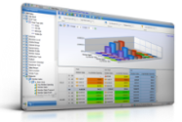
DEVELOPMENT METHODOLOGY
Cognizant proposes a tailored iterative development methodology with defined sets of best practices, standards & templates for QlikView
Iterative
ETL & QlikView Development
Conference Room Pilot
1-2-3
Project Initiation and Due Diligence and Analysis
System & User Acceptance Testing
Production Roll Out
Technical Design
Cognizant Methodology
Visualization
CRP n.. Development
1st Cut Dashboards
Final Cut
CRP 1-Development
2nd Cut Dashboards
Final Dashboards
Cognizant
Customer
Project Manager, Business Analyst, QlikView Architect, QlikView Developer, ETL Developer, Tester, Graphic Designer
Stakeholders
Program Manager, Business and IT SMEs

Slide 18
VISUALIZATION APPROACH
Cognizant proposes an iterative approach for visualization of reports.
Based on our experience with similar engagements, Cognizant has identified the following steps as best practices in delivering effective visualization.
Dashboard Layout Design & Identification of KPIs and Metrics
Paper Prototype
Conceptual Design
Detailed Design
Clickable Prototype
Visual Attributes
Integration of Data & View Development

Slide 19
DUE DILIGENCE AND ANALYSIS
Due Diligence
Due Diligence is one of the critical phase in a Qlikview Project
During Due Diligence, details of each and every reports which need to be created in the application is documented
This stage included detailing of reports, mapping of source systems with the reports, collecting and creating data set and drafting a BRD (Business Requirement Document)
If there reports are not available in the existing system and are completely new to be developed, the entire logic is created in an excel with limited data set or a SQL query is developed along with a data set to validate the logic in Qlikview
Analysis
Analysis involves designing of a draft layout of the requirements as well as identifying and mitigating the GAP’s which can affect the development
The strategy to design the dashboard and level of information which need to be showcased is also drafted during stage
Due Diligence and Analysis phases mitigate:
The risk of changes in the requirements
The issues in mapping the sources and creating data model which delays the project implementation and delivery

Slide 20



DUE DILIGENCE AND ANALYSIS
Due Diligence is one of the critical phase in a Qlikview Project
During Due Diligence, details of each and every reports which need to be created in the application is documented
This stage included detailing of reports, mapping of source systems with the reports, collecting and creating data set and drafting a BRD (Business Requirement Document)
If there reports are not available in the existing system and are completely new to be developed, the entire logic is created in an excel with limited data set or a SQL query is developed along with a data set to validate the logic in Qlikview
Due Diligence
Analysis involves designing of a draft layout of the requirements as well as identifying and mitigating the GAP’s which can affect the development
The strategy to design the dashboard and level of information which need to be showcased is also drafted during stage
Due Diligence and Analysis phases mitigate:
The risk of changes in the requirements
The issues in mapping the sources and creating data model which delays the project implementation and delivery
Analysis

Slide 21


DUE DILIGENCE AND ANALYSIS
Due Diligence is one of the critical phase in a Qlikview Project
During Due Diligence, details of each and every reports which need to be created in the application is documented
This stage included detailing of reports, mapping of source systems with the reports, collecting and creating data set and drafting a BRD (Business Requirement Document)
If there reports are not available in the existing system and are completely new to be developed, the entire logic is created in an excel with limited data set or a SQL query is developed along with a data set to validate the logic in Qlikview
Due Diligence
Analysis involves designing of a draft layout of the requirements as well as identifying and mitigating the GAP’s which can affect the development
The strategy to design the dashboard and level of information which need to be showcased is also drafted during stage
Due Diligence and Analysis phases mitigate:
The risk of changes in the requirements
The issues in mapping the sources and creating data model which delays the project implementation and delivery
Analysis

Slide 22
DUE DILIGENCE AND ANALYSIS
Due Diligence
Due Diligence is one of the critical phase in a Qlikview Project
During Due Diligence, details of each and every reports which need to be created in the application is documented
This stage included detailing of reports, mapping of source systems with the reports, collecting and creating data set and drafting a BRD (Business Requirement Document)
If there reports are not available in the existing system and are completely new to be developed, the entire logic is created in an excel with limited data set or a SQL query is developed along with a data set to validate the logic in Qlikview
Analysis
Analysis involves designing of a draft layout of the requirements as well as identifying and mitigating the GAP’s which can affect the development
The strategy to design the dashboard and level of information which need to be showcased is also drafted during stage
Due Diligence and Analysis phases mitigate:
The risk of changes in the requirements
The issues in mapping the sources and creating data model which delays the project implementation and delivery

Slide 23

DUE DILIGENCE AND ANALYSIS
Due Diligence is one of the critical phase in a Qlikview Project
During Due Diligence, details of each and every reports which need to be created in the application is documented
This stage included detailing of reports, mapping of source systems with the reports, collecting and creating data set and drafting a BRD (Business Requirement Document)
If there reports are not available in the existing system and are completely new to be developed, the entire logic is created in an excel with limited data set or a SQL query is developed along with a data set to validate the logic in Qlikview
Due Diligence
Analysis involves designing of a draft layout of the requirements as well as identifying and mitigating the GAP’s which can affect the development
The strategy to design the dashboard and level of information which need to be showcased is also drafted during stage
Due Diligence and Analysis phases mitigate:
The risk of changes in the requirements
The issues in mapping the sources and creating data model which delays the project implementation and delivery
Analysis

Slide 24



Due Diligence is one of the critical phase in a Qlikview Project
During Due Diligence, details of each and every reports which need to be created in the application is documented
This stage included detailing of reports, mapping of source systems with the reports, collecting and creating data set and drafting a BRD (Business Requirement Document)
If there reports are not available in the existing system and are completely new to be developed, the entire logic is created in an excel with limited data set or a SQL query is developed along with a data set to validate the logic in Qlikview
Due Diligence
Due Diligence is one of the critical phase in a Qlikview Project
During Due Diligence, details of each and every reports which need to be created in the application is documented
This stage included detailing of reports, mapping of source systems with the reports, collecting and creating data set and drafting a BRD (Business Requirement Document)
If there reports are not available in the existing system and are completely new to be developed, the entire logic is created in an excel with limited data set or a SQL query is developed along with a data set to validate the logic in Qlikview

Slide 25
Due Diligence is one of the critical phase in a Qlikview Project
During Due Diligence, details of each and every reports which need to be created in the application is documented
This stage included detailing of reports, mapping of source systems with the reports, collecting and creating data set and drafting a BRD (Business Requirement Document)
If there reports are not available in the existing system and are completely new to be developed, the entire logic is created in an excel with limited data set or a SQL query is developed along with a data set to validate the logic in Qlikview

Slide 26
CRP AND TESTING
Conference Room Pilot (CRP)
CRP helps in creating a constant touch with the business users which will provide a pace to the development
The users will get the first cut of the reports as soon as they are created and tested by the development team
Testing
Testing involves internal first level testing by the development team followed by integration testing and UAT (User Acceptance Testing)
If the testing is for migrated reports then the data set and results of the original report will be leveraged for validating the migrated report
The assumption is that the original report is functionally valid and produces correct results
For new reports the logic is built in Excel/SQL to validate the output of the report
Integration testing involves validating the user access after deployment on the server.
PS: Performance testing is not part of testing, it comes under the Services provided by Qlikview COE

Slide 27
IMPLEMENTATION CONSIDERATIONS
Influential Factors
Potential Issues
Cognizant Recommendation
Size of the database
Data puling and delta load
Ensure proper data refresh dependency has been take care before application deployment
DATA
Number and types of integration points
Application Architecture & Data Flow
Ensure proper data refresh dependency has been take care before application deployment
Total number of users
Number of servers required
Identify the business goals and establish requirements for Qlik at high-level.
USER BASE
Number of concurrent users
Data flow & server performance
Decide on load balancing , development model and data split
3rd party integrations
Application Performance & Authentication
Ensure all the features of 3rd party integration have been taken care before deciding on webservers and number of server nodes
GEOGRAPHICAL
SPEREAD
(APPLICATION)
Load Balancing
Clustering and central processing
Identify the load on the server & back up. Plan for disaster recovery before deciding on the load balancing and server cluster
User Growth
Performance & authentication issues
Evaluate and finalize scalability options (vertical or horizontal)
SCALABILITY
Increase in number of QlikView applications
Application maintenance effort; User management & Server performance
Ensure application distribution plan & data growth has been considered before start of the application development

Slide 28
ADOPTION AND GOVERNANCE MODEL

Slide 29
QLIKVIEW ADOPTION PERSPECTIVES
What are the Parameters
to evaluate Adoption?
What is my Adoption
Maturity level?
Penetrate
Percolate
Embrace
Partner
Pervade
QlikView User Base Coverage
Cognizance
Craving
Capability
Care
Change
Alignment w/ Strategy & Management
Frequency of QlikView Usage
QlikView Adoption
How to ensure
effective Adoption?
Extent of Business Enablement
Type of QlikView usage

Slide 30
EFFECTIVE ADOPTION OF QLIKVIEW | A CHANGE ADOPTION MODEL
Cognizance
Craving
Capability
Care
Change
Posters, Pamplets
Cognizance is about creating consumer awareness around QlikView
Provide knowledge of change and outline its significance
Inform ‘What’s in it’ to consumer at large and to corporation
Banners, Brochures
Workshops
Forums
Craving is to create consumer interest to participate and engage
Mobilize the supporters, to-be ambassadors, speakers to change
Speak up to the capability, care, road map, corporate alignment
Leadership
Cascade
Volunteer
Opportunities
Demonstrate QlikView Analytics capabilities to address business queries
Train the Trainers & provide hands-on experience to volunteers, BAs
Create example Dashboards that enhance any existing of BO/Spotfire
Act upon feedback, ask support expectations and current issues
Training &
Material
Working Sessions
Care is about demonstrating consumer support structure in place
Ensure creation and existence of IT Support, Business Support, Governance Support, Library, Collaborative Environment for Consumers
Show processes and procedures in place for all consumer requests
Win consumer confidence on care structure & willingness to change
Governance
Business & IT Support
CollaborativeSharepoint
Rollout QlikView to various LOB’s as per rollout plan
Ensure production support and demonstrate support metrics to Lines of Business yet to adopt QlikView
Generate metrics & publish to collaborative SharePoint sites & Leadership
Implement
Rollout
Sustain

Slide 31
SCOPE OF GOVERNANCE
Scope of Governance in the context of rolling out QlikView/BI Tool Enterprise wide
BI Architecture (QlikView)
BI Technology & Tools supporting Architecture
BI Requirements & supporting BI Data Assets
BI Reports/Analytics/Dashboards
BI Information Access/Usage/Support
BI Metrics (Performance/Adoption)
BI Communication
Line of Business Executives
BI Process Owners
BI Managers & Business/Subject Stewards
IT Management (owning Architecture, Technology, Tools)
BI Data & Security Administrators
TECHNOLOGY
STEWARDS
WHAT
WHO
WHAT TO GOVERN
WHO TO GOVERN
SCOPE
WHEN TO GOVERN
WHY TO GOVERN
WHEN
WHY
Technology, Tool Implementation Points
BI Requirements Capture, Change
BI Data Transformation/Migration
BI Reports Conversion/Implementation
BI Access/Usage Change
Deployment Methodology Phase Transitions
Alignment with BI Strategy/Business
Communication, Control
Clear Accountability, Conformity
Stakeholders/Consumers Confidence
Effective Adoption & Usage
Ability to Monitor, Measure, Maintain
(PEOPLE) STAKEHOLDERS
PROCESS

Slide 32
WHAT IS REQUIRED TO GOVERN QLIKVIEW?
A STRUCTURE TO ROLE/PERSON/RACI
Structure
Responsibilities
Accountable
Consulted
BI Governance Council
Governance Direction, Strategy setting
Champion CoE Mission & Objectives
Conflict resolution, Prioritization
Operational liaisons
Review & Approve policies
Governance Polices
Conflict Resolution
Program Priorities
Enterprise Governance
Policies
Standards and Benchmarks
BI
Governance
Council
BI Governors,
LOB, Process Stewards
Applicable Roles: VP/AVP,
Sr./Director, IT Architect
QlikView CoE
QlikView Consulting Services
Assessment and Architecture Services
Delivery and Execution Services
Upgrade and Rollout/Implementation Services
Production Support and Maintenance Services
Training and Certification
Research Services
Architecture
Infrastructure
SOPs
QlikView Policies and Standards
QlikView COB
QlikView Adoption
QlikView Assets
Strategy changes
Policy/Process changes
IT Architectural considerations
Prioritization of activities
QlikView COE
QlikView
Program Liaisons
Technology Liaisons
Applicable Roles:
Program Manager, BI Manager, Technical/Solution/QV-Architect
QlikView Stewardship Team
Perform Analysis, Deployment & Delivery
Implement polices, Business rules
Perform operational activities - quality analysis, performance analysis, sizing
Review QlikView New Application/Report CRs
Review BI Self Service Creations
Review QlikView Report/Applcs CRs with CoE
Quality, Sizing, Performance, Metrics
System Availability
Controlling QVD Files & Reports Proliferation
QV/Tool Architecture considerations
Business Rule changes
Templates, Tool, Applic, Technology
QlikView/Report
Stewardship Team
QlikView Lead
QV Technical Stewards
Applicable Roles:
QlikView Leads, QV Mart Administrator, Project Manager, Performance Analyst, BA, DBA
Adopt and Practice QlikView/BI Policies, Standards
Imbibe Governance as a way of work
Raise flag and take necessary action
Applicable Roles : Analysts, Developers, Testers
Consumers
Practitioners

Slide 33
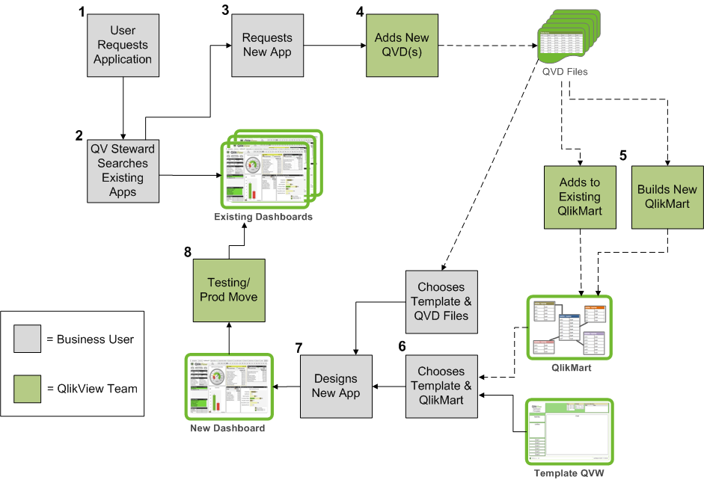


QLIKVIEW APPLICATION CHANGE REQUEST GOVERNANCE & APPLICATION FLOW
Key Consideration
Duplication
Performance
# of Users
Volumes
User Group
Users raises
New App CR
Upon
NOT finding
Queues into
QV Team &
User
Notified
QV Mart
Admin
Adds
QVD(s)
Y
Approved CR?
Report Rationalization Artifacts
QV Steward
verifies App
in Enterprise
Library
Report
Rationalization
Artifacts
Looks
up
Adds to existing
QlikMart
Builds New
QlikMart
Tool Functionality
User Capability
Mapping matrices
PROD QV Team
Implements
Seeks QV COE or
Stewardship
Group Approval
if required
Users
Chooses
Template
QVD Files
Business UAT
Users
Designs
New Applc
Users
Chooses
Template
QlikMart
Seeks CoE Leads
or BI Councils
Approval
if required
BI Governance Council
Consumer
Practitioners
QlikView
COE
QlikView
Stewardship

Slide 34
ACCELERATORS

Slide 35
QLIKVIEW SOLUTION – iMetaView
Voice of Customer
Problem description
Solution
Multiple failure points during EDW Journey
No consistency across systems
Lack of understanding of system stability and scalability
Inability to co-relate cause and effect
Integrated model providing holistic view – Scalability and Stability
Drilldown capability (within and across)
Business does not trust the data that is presented
Error notification will be helpful to find faults
Lack of reliable and timely information delivery
Availability and Data quality impacting usability
Introduce industry standards and verified compliance levels
Proactive monitoring of data quality and data availability trends
Current solution not focused at enterprise level
Lack of benchmarks and baselines
Missing continuous monitoring and alerting
Enabling definition of enterprise level benchmarks
Single coherent point of continuous verification
Enterprise Operational Analytics – EOA provides an expandable & integrated view of Database metadata, Data Integration (ETL) metadata and Business Intelligence (Reporting) metadata to drive Operational Efficiency and provide robust governance mechanism for monitoring & continuous service improvement in any Enterprise Data Warehouse
“Cognizant brought BI to our BI environment”….. Customer Testimonial

Slide 36
QLIKVIEW ACCELERATOR – QVS CAL Manager
Voice of Customer
Problem description
Solution
Difficulty in automating license allocation using QMC
Not able to monitor inactive users
Difficulty in Identifying In-Active users
Inability to clear unused license after a period of time
Qlikview Dashboard to monitor the license usage from multiple servers
Also provides the details of allocated and Unallocated Licenses in Server
Manual effort needed in clearing unused licenses
Monitoring license usage of different types (Eg. Document CAL, Named CAL, Usage CAL etc.)
Usage of .NET API to remove unused licenses after a period of time
Users having more than one type of license
Identifying license type required for a user based on the frequency of usage
Suggestion of license type needed based on frequency of usage and number of documents need to be accessed
Need of cost effective license model
QVS CAL Manager is a comprehensive License Management Tool for Qlikview Implementations. It is built by using Qlikview’s inherent License Information and .NET APIs there by making deployments easy to make. The tool can also provide insights of Licenses from multiple servers, providing a unified view of the entire License Information

Slide 37
QLIKVIEW ACCELERATOR – QVD Monitor
Voice of Customer
Problem description
Solution
Difficulty in tracking and monitoring the data loads in to QV applications on daily basis
Difficulty in identifying number of records loaded into the application while doing the normal refresh / incremental refresh
Qlikview Dashboard to provide the meta data information including number of rows fetched, Size, time taken to load, QVDs used in an dashboard etc.,
Monitoring data loads manually or asking DB team for the information is pretty much difficult in a longer run
No available built-in tool to automatically report on the data load details
A script will be included in all the application which would generate the data for the QVD Monitor and store in a QVD
Monitoring and Tracking Multiple Qlikview applications across multiple environments is difficult and so is getting a unified view
Analysis of all the information at one place enables the customer to monitor their daily load as well the meta data information
Need of Centralized solution to get all this information
QVD Monitor is a comprehensive Meta Data Management Tool for Qlikview Implementations. It is built by using data driven from the Qlikview applications . The tool can also provide insights of data loads from DB, QVDs used in the dashboard, Record details fetched from DB, size of the data and time taken for loading the data.

Slide 38
QLIKVIEW SOLUTION – QAdmin
Voice of Customer
Problem description
Solution
Multiple application for the Qlikview Administration
No multiple Environment setup
Reload takes long time
Single application to handle Qlikview Administration activities
Currently only single environment setup is available in the dashboard
Reload takes about 1-2 hrs. for single Environment.
Holistic view of the Qlikview Administration
Proactive monitoring of data in the single Qlikview application
Reload takes <30 Mins for all 3 environments currently setup
Task Run Time and Task History Data not available in the System and Governance Dashboard
Task run time on split Hours
Details about task reload history
No. of tasks running on each hour and time on which the application gets reloaded
Gives previous 30 Days application Reload history of the tasks
Integrated model provides the split reload timing of all tasks across various environments
AD Group Information
CAL Management Details
Add/Remove user in the multiple tasks
List of users in each AD Group
CALs for the different Users
Adding/Removing users
Users mapped with the various AD Group Information
WHAT IF Analysis
Automated User Access
QAdmin - QAdmin gives a complete end to end integrated set of information for the QlikView admin to handle their day to activities in an effective manner. The key differentiator for this tool is that it collaborates all the necessary information that a QlikView Admin needs to manage the entire QlikView environments
“Cognizant brought BI to our BI environment”….. Customer Testimonial

Slide 39
.
CASE STUDIES and SAMPLE VISUALIZATIONS

Slide 40
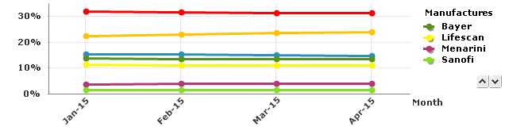
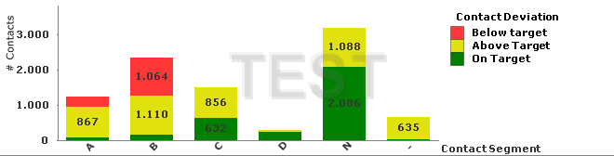












CASE STUDY 1
JPMC IT Risk
Client Situation
Cognizant Solution
Client Benefits
Firm wide reporting platform with more than 23 different data categories to report on.
Complex entitlement model varying from data level entitlements to tiering entitlements to context level entitlement.
Out of box functionalities like preview and promote and customized alerting through mail.
Cross context reporting which demands interdependency between different data categories.
Provided cost effective solution by implementing 25 executive dashboards
Provided robust and scalable QlikView data model.
Implemented complex security model and integrated the solution with Enterprise Entitlements .
Handled complex user navigation and Preview/Promote functionality using QlikView dashboards
Provided single point of executive dashboard for enterprise operational risks
Provided cost effective solution with Onsite\offshore model
Deploying emerging business requirements in a timely and flexible manner.
Provided Data Quality Dashboard and RCSA which made firm compliant with BCBS 239.
Robust and scalable QlikView infrastructure and data model.
The application has preview and promote functionality which allows the Data Owners to preview the data before promoting it to all the users.
Key Metrics:
No. of KPI’s – ~100
No. of Tabs – 27
No. of Charts – 108
Row Count – ~ 11million/year
User count – ~150
Size of each application – ~30MB-100MB
Source Data
Common Stage
Data Warehouse
Data Views
Information Delivery
Connectivity
Reporting Layer
Database: Oracle
ETL: Information
UI: .NET
S1
S2
DIM location
Others
A
Views
Standard/ Ad-hoc
F1
F2
Generic
Staging
Generic
Fact
Generic
Fact Summary
Materialize View
B
List
DIM Employee
DIM Line of Business
Physical Table
Dashboard
C

Slide 41
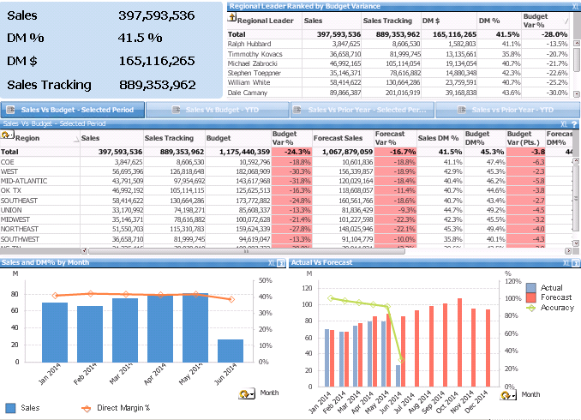
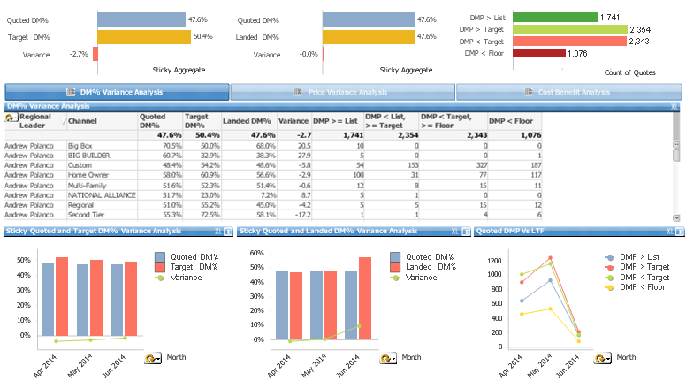
CASE STUDY 2 Leading Construction and Building Supplies Company
Client Situation
Cognizant Solution
Client Benefits
The Customer is a manufacturer of products for the home improvement, construction markets, provider to a variety of installed products and services. Comprising more than 20 companies, the client operates nearly 60 manufacturing facilities in the US and over 20 in other parts of the world.
Key Challenges
Needs a core set of agreed metrics, tied to business strategies and priorities
Too much time/effort is being spent on manually integrating data from multiple sources
Lack of a consistent tool set leads different people to report different results from the same underlying data
Cognizant assessed current model and proposed a roll-out plan as per customer priority
Scattered KPI’s are re-scoped under appropriate subject area for better data presentation and Implemented effective solution using Qlikview.
Implemented a set of flexible dashboards with filters, prompts, graphs, drill up/down, & column selector capabilities to analyze KPIs
E.g. Budget / Goal, Actual Revenue, Gross Profit, Gross Margin and visits duration, etc.
Provided cost effective solution with Onsite/Offshore model.
Robust and scalable QlikView infrastructure and data model.
Sales Analysis dashboard provided KPI’s like Budget Amount, Goal Amount, Revenue Amount, Direct Margin Analysis for end users.
Pricing Dashboard provides analysis on KPI;s No. of Quotes approved and No. of Quotes Rejected, Won/Lost Quotes.
Currency Conversion solutions provided to analyze the KPIs in preferred currencies.
Multilingual analytical solution provided for Operations Dashboard.
Key Metrics:
Number of Qlikview Dashboards – 9 Dashboards having 50 KPIs
Number of Users – 1000
Number of concurrent users – 300
Qlikview server – 2
Qlikview Publisher – 2
Data Size - 10 Million Records

Slide 42
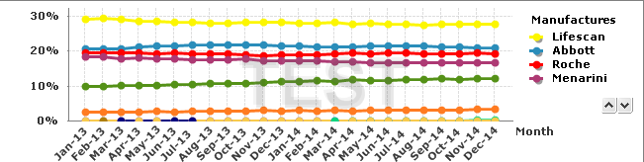
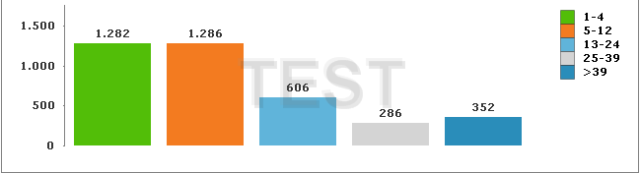
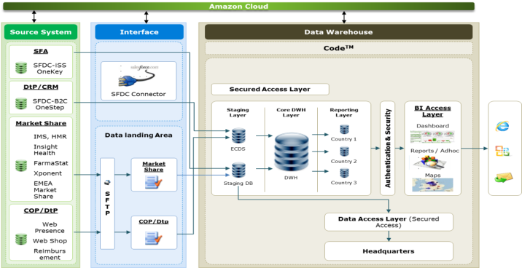
CASE STUDY 3 Leading Pharmaceutical Company
Client Situation
Cognizant Solution
Client Benefits
Existing application is unable to support the new business requirements and also unable to meet the dynamics of the business in in terms of deploying newly emerging business requirements in a timely and flexible manner.
In the existing system there were more than 215 reports.
Most of the existing reports were redundant and were created due to inflexibility of the existing reporting application
Cognizant is building an integrated platform providing commercial insights with single version of the truth across EMEA for the client.
The KPIs, attributes, facts and dimension of existing reports were analyzed and compared. Keeping in mind the features of Qlikview, the report consolidation exercise was performed.
Consolidation of reports in Business Intelligence Application hosted on Amazon Web services Cloud
Reports precisely guide the marketing team’s ability to efficiently collect, measure and analyze the DtP centric information
Deploying emerging business requirements in a timely and flexible manner.
Deployment of secure Cloud Hosted solution for managing cost and demand sensitivities without compromising on scalability needs
Application is available through internet so end users can access it across the globe.
Key Metrics:
No. of KPI’s – 39
No. of Tabs – 9
No. of Charts – 40
Row Count – 93 million
User count - 300
17 countries access the application.
Size of the application – 1.5 GB
Connectivity
Data from different data sources like sales force, CRM,IMS was loaded in ADS layer
Qlikview connected with ADS layer.

Slide 43
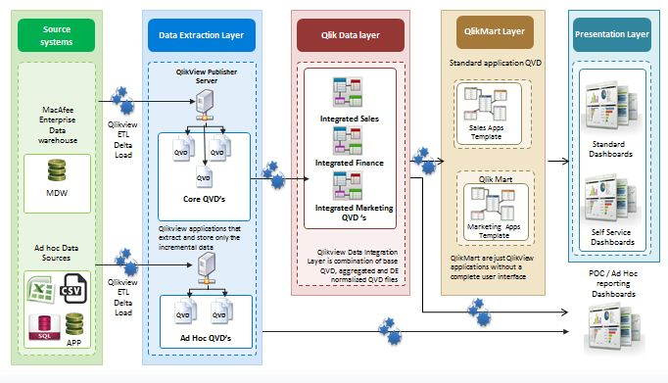
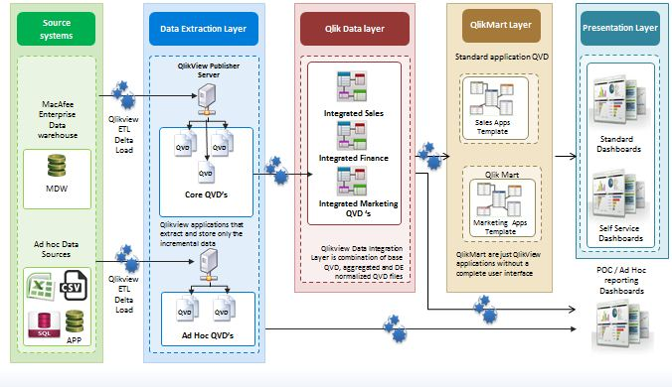
CASE STUDY 4 Leading Security Software Technology Company
Client Situation
Cognizant Solution
Client Benefits
The customer is world’s leading security technology client seller focused on security related technologies. The key challenges were implemented to deliver customizable , stabilized reports and dashboards
Key Challenges:
Access to all dashboards outside the domain area
Stability of the environments
Lack of Clarity on Server Management
Drill down and drill through dashboards and reports
Migration and deployment of Dashboards
Extranet web server implementation
Infrastructure setup for DR, DEV, QA and PROD environment
Cognizant proposed and implemented a appropriate solution using Qlikview
Extranet webserver were implemented which enhanced the stability in environment
Customized reports were created which helped the users to edit the dashboards with desktop license in user system based on the dimension selected
Initiated and followed the process for migration of documents
Integration of QVDs to ensure proper data modelling to enhance faster response time.
Server Maintenance were done on regular basis
Provided cost effective solution with Onsite\offshore model
Robust and scalable infrastructure and data model
Provided group level and data level security
Session is controlled by power user which allows user to view dashboard without using license
Improved data control and sanity and helped users to share their objects
Provided access for external users through extranet web server
Key Metrics:
Number of QlikView Dashboards and Objects – 4 Dashboards having 150 KPIs
Number of Users – 605
Number of concurrent users – 100
Number of External Users – 150
Qlikview server – 6 ,
Qlikview Publisher – 2
Data Size - 5 Million Records

Slide 44
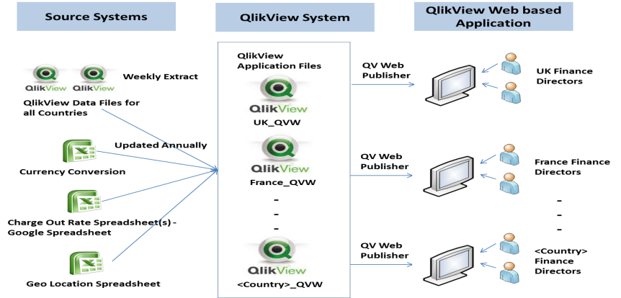
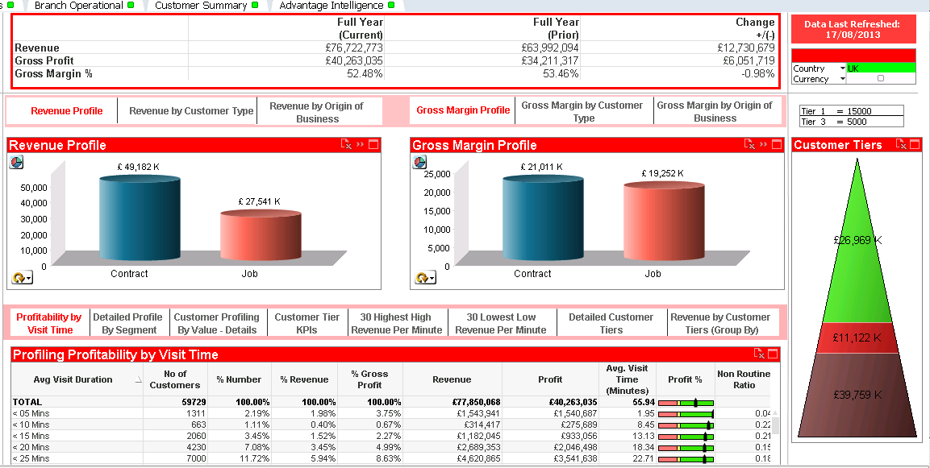
CASE STUDY 5 Leading Hospitality and Professional Services Company
Client Situation
Cognizant Solution
Client Benefits
The customer is providing various hospitality services like pest Control, Hygiene, textile, etc... in Europe, US & Pacific regions. Key challenge for the customer is to understand profitability of the business across regions.
Key Challenges
unavailability of single version of truth of their sales and services data
Report generation from iCABS didn't give good visibility on data for decision makers
Lack of uniform KPIs across various levels of business users
Data is in local currency fore each country
Integration of data from iCABS, EIS, Pest Pac, Power 7 and flat files was difficult as each data source and data format are different
Cognizant assessed , proposed and implemented appropriate solution using QlikView.
Cognizant designed flexible data model with 120 dimensions & 6 fact tables, in order to store detailed sales and operational data, which enabled to track history of each change in their attributes/activities.
Implemented a set of flexible dashboards with filters, prompts, graphs, drill up/down, & column selector capabilities to analyze KPIs
E.g. Revenue, Gross Profit, Gross Margin and visits duration, etc.
Provided cost effective solution with Onsite/Offshore model.
Robust and scalable QlikView infrastructure and data model.
Customer Profitability Analytics solution using tools like QlikView to analyze KPIs E.g. Revenue, Gross Profit, Gross Margin and visits duration to understand the profitability of each customer.
Currency Conversion solutions provided to analyze the KPIs in preferred currencies
Multilingual analytical solution provided for Operations Dashboard
Key Metrics:
Number of QlikView Dashboards and Objects – 9 Dashboards having 150 KPIs
Number of Users – 1200
Number of concurrent users – 500
Qlikview components – Qlikview server – 4 , Publisher – 4
Data Size - 10 Millon Records

Slide 45
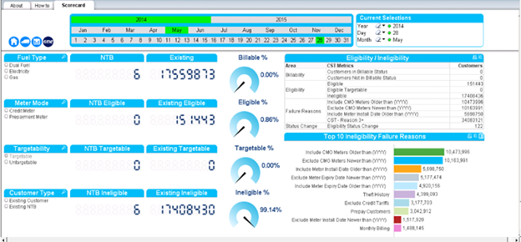
CASE STUDY 6 UK’s Leading Energy and Utilities Company
Client Situation
Cognizant Solution
Client Benefits
Client wanted to display an overview of all the high level summaries of the Management Information for the Business Needs. The Reports include the Eligibility/Ineligibility, Account Status , Conversion and Tariff, Appointment and Installation , Register Interest and SCA MI dashboard
Key Challenges
Changing Business Requirement
Delay in procurement of User license
Delay in Mapping /Business rules
Non availability of Data
QlikView Connectivity to source system
Cognizant assessed , proposed and implemented appropriate solution using QlikView.
Cognizant designed flexible data model with 55 dimensions & 10 fact tables, in order to store and build the dashboard and reports .
Implemented a set of flexible dashboards with filters, prompts, graphs, drill up/down, & column selector capabilities to analyze KPIs .Report will be at weekly granularity rather than monthly
E.g. Top 5 traffics, traffic Time Slice, Billable %, Eligible % etc.
Improved productivity for the Client’s Executives
Increased Dashboard adoption through enablement programs & helpdesk support
Centralized reusable components, best practices and KPIs
Accelerated decision making
Building greater accountability through transparency and speeding the strategic decision making process
Technology Landscape|
Database: Hadoop, CST,SAP ISU,SAP CRM,TAMI and Communisis
ETL & Reporting Tool : QlikView 11.2 SR3
Key Metrics:
Number of QlikView Dashboards – 6
KPI’s - 112
Number of Users – 30
Data Size - 2 Billion Records

Slide 46
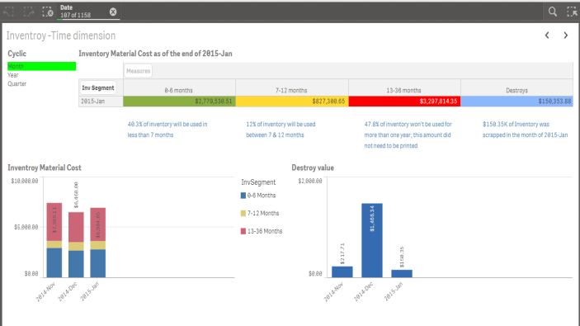
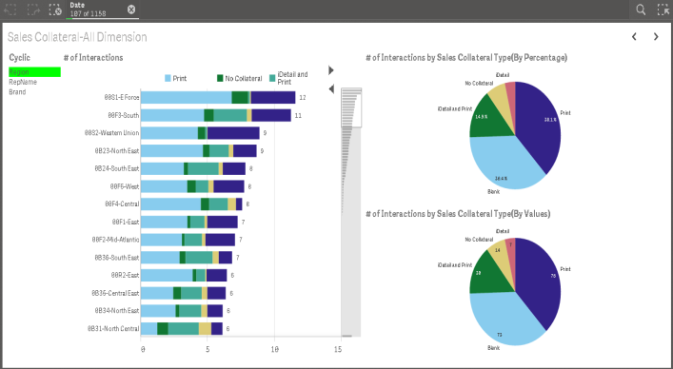
CASE STUDY 7 QlikSense – A Leading Bio-Technology Company Based in the US
Client Situation
Cognizant Solution
Client Benefits
The Customer is a biotechnology corporation
which markets itself as a research-driven corporation that follows the science to make innovations. It employs more than 1,100 researchers, scientists and postdocs and covers a wide range of scientific activity—from molecular biology to protein chemistry to bioinformatics and physiology.
Key Challenges
Needs to Migrate the QlikView Applications to QlikSense
Need to merge the Dashboards of 2 Products into a single Dashboard
Individual dashboards are used in QlikView for each product.
Cognizant assessed current model and proposed a roll-out plan as per customer priority
Integrated the Base Data model used in the 2 separate application in QlikView into
a single Data model
Created the QlikSense Application for the 2 Brands using the merged Data model with all the possible features available in QlikSense
Implemented a set of flexible dashboards with filters, graphs, cyclic groups,Master Items that enables user to create their own apps with attractive visualization features
E.g. Utilization All Dimension, Inventory All Dimensions, Forecast, Account Overview etc.
Provided cost effective solution with Onsite/Offshore model.
Robust and scalable QlikSense infrastructure and data model.
Achieved most of the features used in QlikView in the migrated QlikSense Dashboards.
The dashboards contains Master Items using which users can develop their own Applications
MOI Analytics Dashboard provides analysis on Sales Trends and Account Growth, Inventory and Forecast KPIs with Extension objects for Cyclic group
SLD Dashboards provides analysis on Sales and Account related KPIs for the 2 Brands HER2 and RA
Key Metrics:
Number of QlikSense Dashboards – 2 Dashboards having 95 KPIs
Number of Users – 150
Number of concurrent users – 50
QlikSense Nodes– 3 (Master, Cluster and Proxy)
Data Size - 15 Million Records

Slide 47
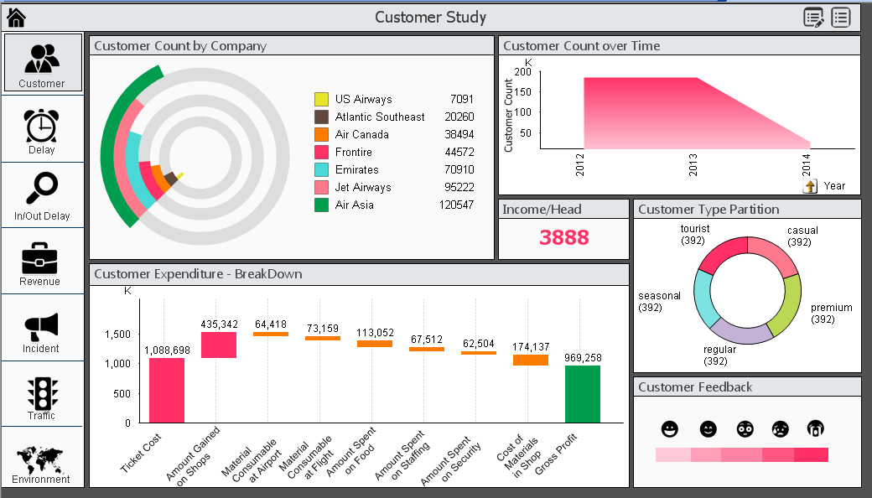
QLIKVIEW SAMPLE VISUALIZATION - 1

Slide 48
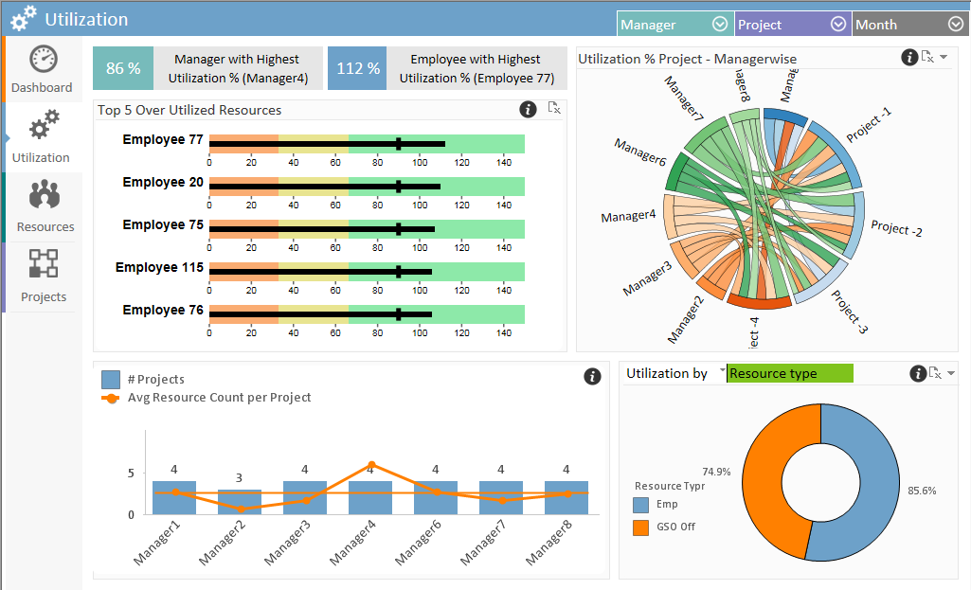
QLIKVIEW SAMPLE VISUALIZATION - 2

Slide 49
.
THANK YOU

